Slide 1
Measurement

Slide 2
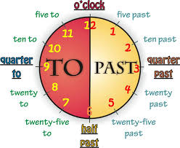
PASSING OF TIME

Slide 3
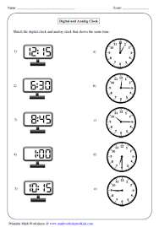
Activity 1
Match the digital time with the correct analog

Slide 4
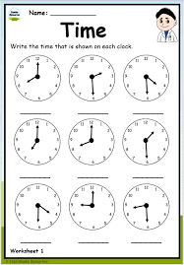
Activities
Write the time shown on the clock

Slide 5
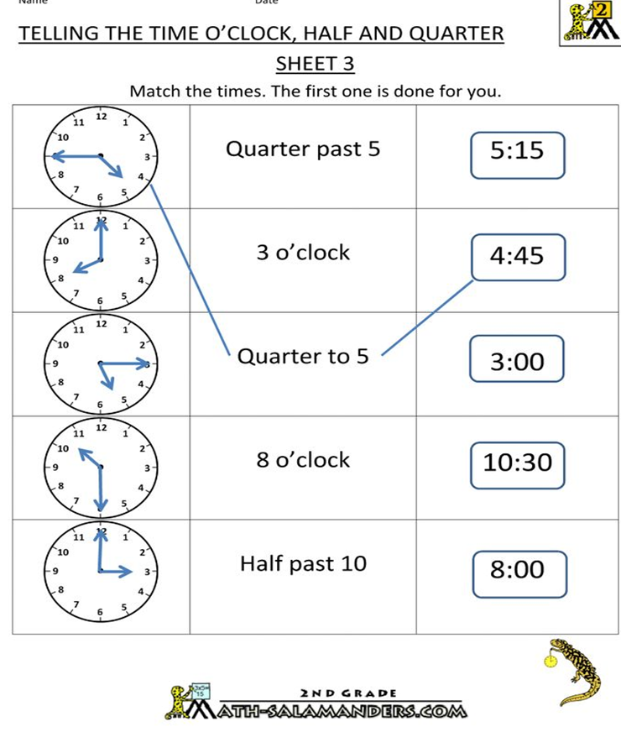
Activity 2

Slide 6
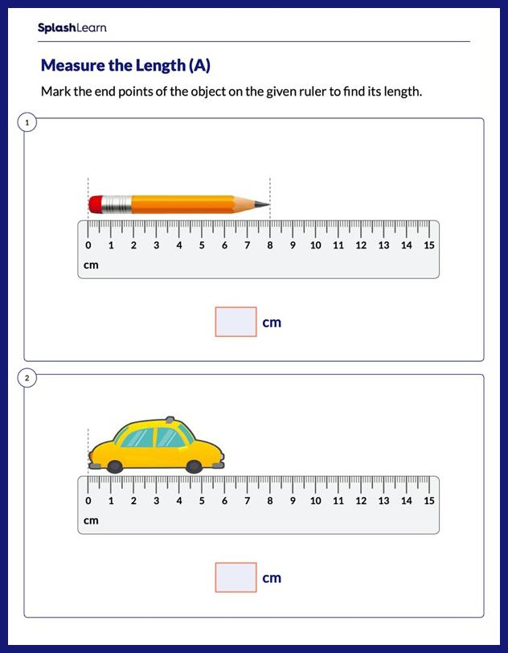
Length

Slide 7
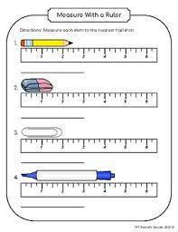
Length
Measure the following objects with a ruler

Slide 8
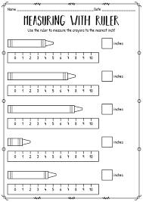
Length

